Slide 1
Spread Spectrum

Slide 2
Spread Spectrum
Form of encoding for wireless communication
Analog or digital data
Analog signal
The basic idea of spread spectrum is to modulate the signal so as to increase significantly the bandwidth (Spread the spectrum)of the signal to be transmitted
Makes jamming and interception harder and improves reception
Two types of spread spectrum:
  Frequency hoping
    Signal broadcast over seemingly random series of frequencies
  Direct Sequence(recently developed)
    Each bit is represented by multiple bits in transmitted signal

Slide 3
Spread Spectrum Concept
Input fed into channel encoder
  Produces narrow bandwidth analog signal around some central frequency
Signal modulated using sequence of digits
  Known as Spreading code/sequence
  Typically generated by pseudonoise/pseudorandom number generator
Increases bandwidth significantly
  Spreads spectrum of the signal to be transmitted
Receiver uses same sequence to demodulate signal
Demodulated signal fed into channel decoder

Slide 4
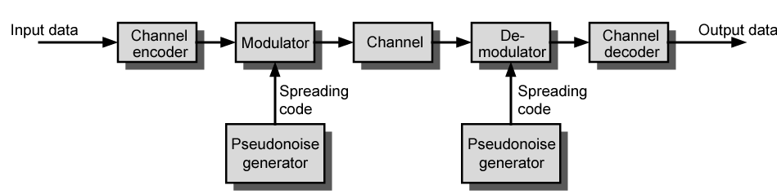
General Model of Spread Spectrum Digital Communication System

Slide 5
Gains
Several gains from this apparent waste of spectrum:
  Immunity from various noise and multipath distortion
  including jamming
  Can hide/encrypt signals
    Only receiver who knows spreading code can retrieve signal
  Several users can share same higher bandwidth with little interference
    Used in Cellular telephony applications with a technique known as Code division multiplexing (CDM) or Code division multiple access (CDMA)

Slide 6
Pseudorandom Numbers
Generated by algorithm using some initial value called seed
Deterministic algorithm
  Not actually random
  If algorithm good, resulting sequences will pass many reasonable tests of randomness
  Such numbers are called pseudorandom numbers
Need to know algorithm and seed to predict the sequence
Only a receiver that shares this information with the transmitter will be able to decode the signal successfully

Slide 7
Frequency Hopping Spread Spectrum (FHSS)
Signal is broadcast over seemingly random series of radio frequencies,hopping from frequency to frequency at fixed intervals
A receiver, hopping between frequencies in synchronization with transmitter,picks up the message
Eavesdroppers hear unintelligible blips
Attempts to jam the signal on one frequency succeed only at knocking out a few bits of it

Slide 8
Basic Operation
Number of channels are allocated for the FH signal
Typically 2^{k} carriers frequencies forming 2^{k} channels
Channel spacing(width) corresponds to the bandwidth of input signal
The transmitter operates on one channel at a time for fixed interval
  300 ms in IEEE 802.11
  During this interval some number of bits transmitted using some encoding scheme
    May be fractions of bit (see later)
  Sequence of channels used is dictated by a spreading code
  Both transmitter and receiver use the same code to tune into a sequence of channels in synchronization

Slide 9
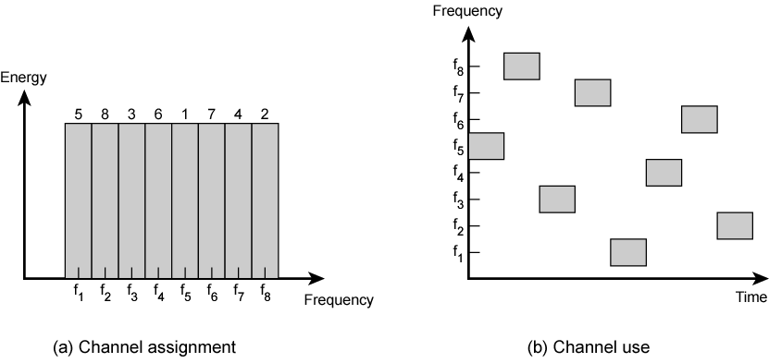
Frequency Hopping signal Example

Slide 10
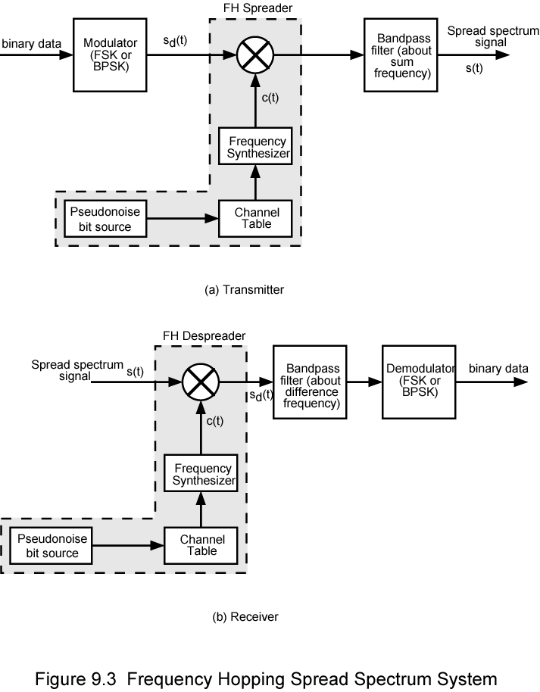
Frequency Hopping Spread Spectrum System (Transmitter)

Slide 11
Frequency Hopping Spread Spectrum System (Receiver)

Slide 12
Basic approach
Transmission
    Binary data are fed into a modulator using some digital-to-analog encoding scheme,such as frequency shift keying (FSK) or Binary phase shift keying(BPSK)
    The resulting signal is centered on some base frequency
    A pseudonoise (PN) or pseudonumber source serves as an index into a table of frequencies
    This is the spreading code
    Each of the k bits of the PN source specifies one of the 2^{k} carrier frequencies
    At each successive interval (each k PN bits), a new carrier frequency is selected
    This frequency is then modulated by the signal produced from the initial modulator to produce a new signal with the same shape but now centered on the selected carrier frequency

Slide 13
Basic approach
Reception
    On reception the spread spectrum is demodulated using the same sequence of PN-derived frequencies and then demodulated to produce the output data

Slide 14
Slow and Fast FHSS
Frequency shifted every T_{c} seconds
Duration of signal element is T_{s} seconds
Slow FHSS has T_{c} ≥ T_{s}
Fast FHSS has T_{c} < T_{s}
Generally fast FHSS gives improved performance in noise (or jamming)

Slide 15
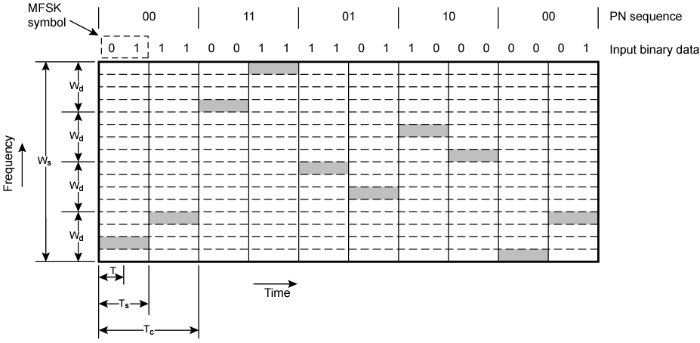
Slow Frequency Hop Spread Spectrum Using MFSK (M=4, k=2)

Slide 16
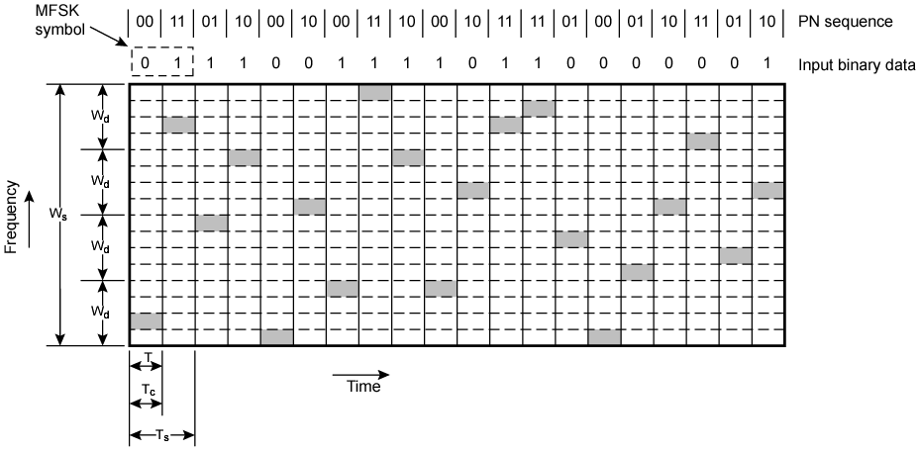
Fast Frequency Hop Spread Spectrum Using MFSK (M=4, k=2)

Slide 17
FHSS Performance Considerations
Typically large number of frequencies used
  Improved resistance to jamming

Slide 18
Direct Sequence Spread Spectrum (DSSS)
With DSSS ,each bit in the original signal is represented by multiple bits using spreading code
Spreading code spreads signal across wider frequency band
  In proportion to number of bits used
  10 bit spreading code spreads signal across 10 times bandwidth of 1- bit spreading code
One method:
  Combine input digital information stream with spreading code using anXOR
  Input bit 1 inverts spreading code bit
  Input zero bit doesn’t alter spreading code bit
  Data rate equal to original spreading code
Performance similar to FHSS

Slide 19
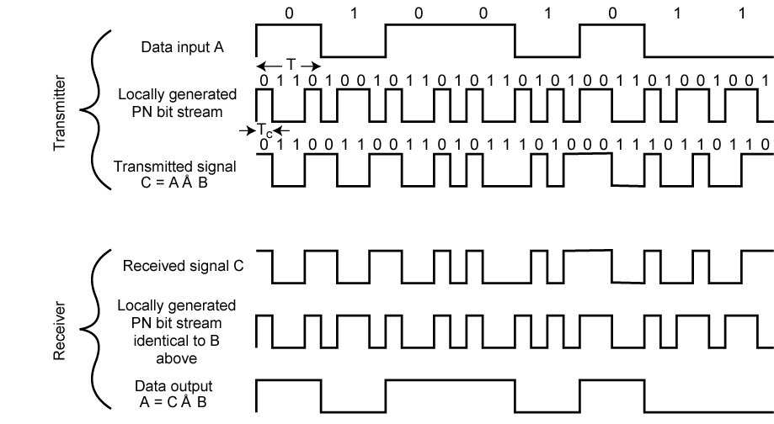
Direct Sequence Spread Spectrum Example

Slide 20
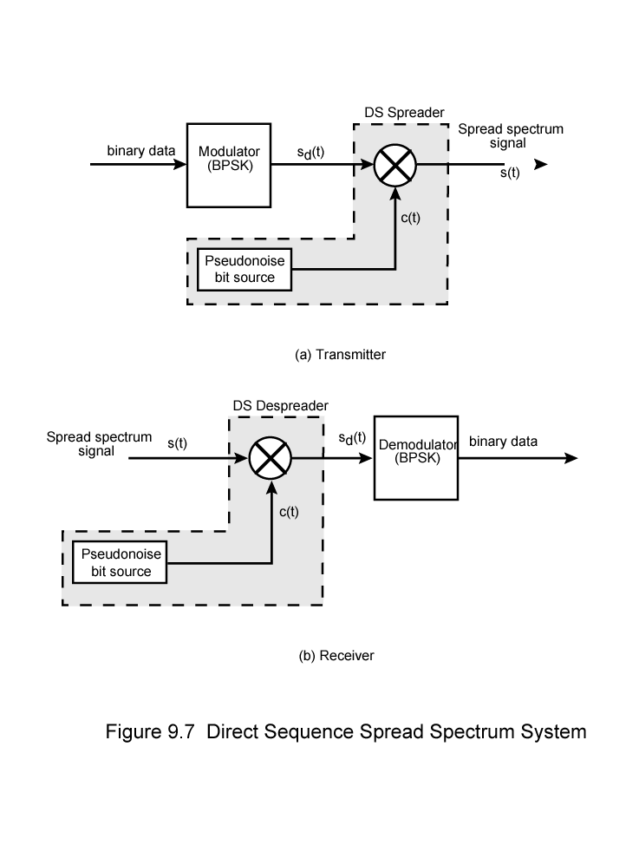
Direct Sequence Spread Spectrum Transmitter

Slide 21
Direct Sequence Spread Spectrum Transmitter

Slide 22
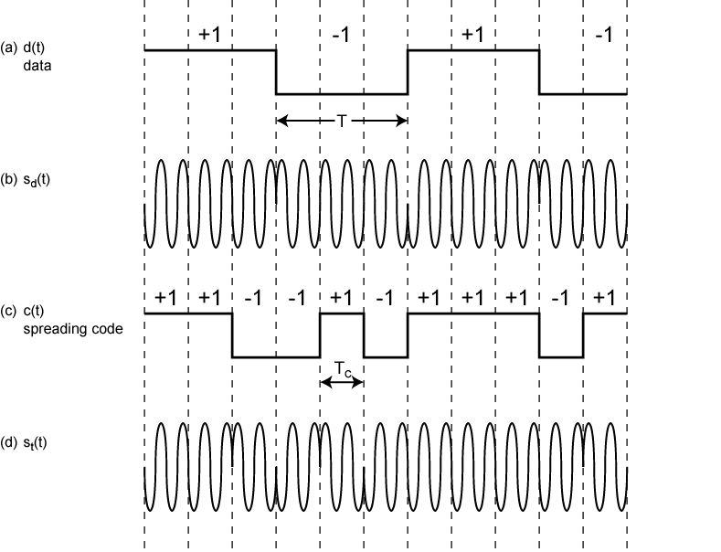
Direct Sequence Spread Spectrum Using BPSK Example

Slide 23
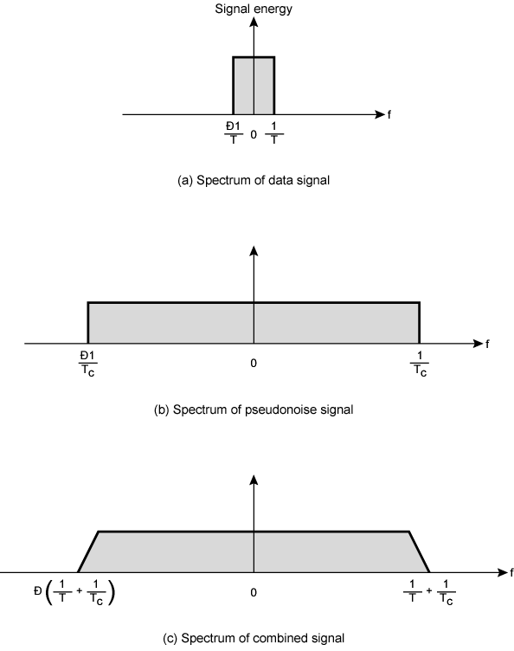
Approximate
Spectrum of
DSSS Signal

Slide 24
Code Division Multiple Access (CDMA)
Multiplexing Technique used with spread spectrum
Start with data signal rate D
  Called bit data rate
Break each bit into k chips according to fixed pattern specific to each user
  User’s code
New channel has chip data rate kD chips per second
E.g. k=6, three users (A,B,C) communicating with base receiver R
Code for A = <1,-1,-1,1,-1,1>
Code for B = <1,1,-1,-1,1,1>
Code for C = <1,1,-1,1,1,-1>

Slide 25
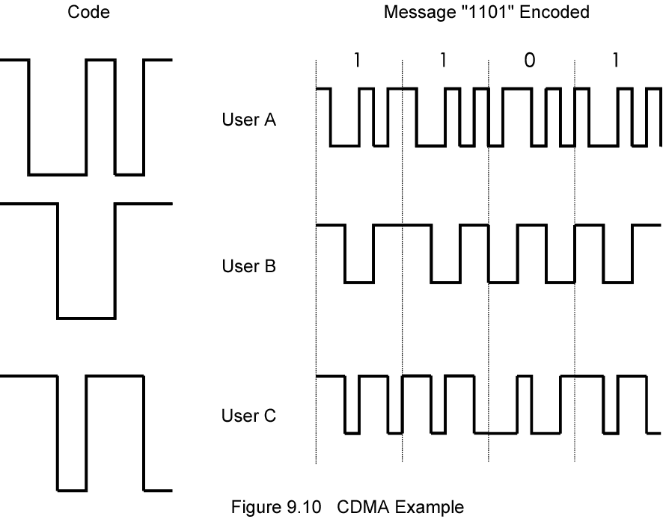
CDMA Example

Slide 26
CDMA Explanation
Consider A communicating with base
Base knows A’s code
Assume communication already synchronized
A wants to send a 1
  Send chip pattern <1,-1,-1,1,-1,1>
    A’s code
A wants to send 0
  Send chip[ pattern <-1,1,1,-1,1,-1>
    Complement of A’s code
Decoder ignores other sources when using A’s code to decode
  Orthogonal codes

Slide 27
CDMA for DSSS
n users each using different orthogonal PN sequence
Modulate each users data stream
  Using BPSK
Multiply by spreading code of user

Slide 28
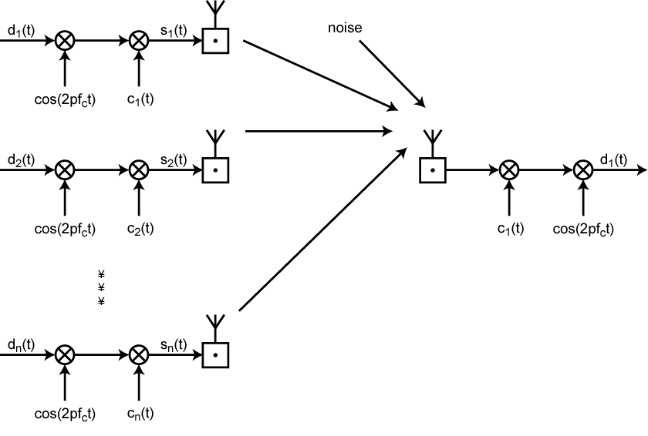
CDMA in a DSSS Environment

